Slide 1



Rekening 2024
View in Power BI
Last data refresh:
3-6-2025 05:03:42 UTC
Downloaded at:
3-6-2025 07:59:42 UTC

Slide 2
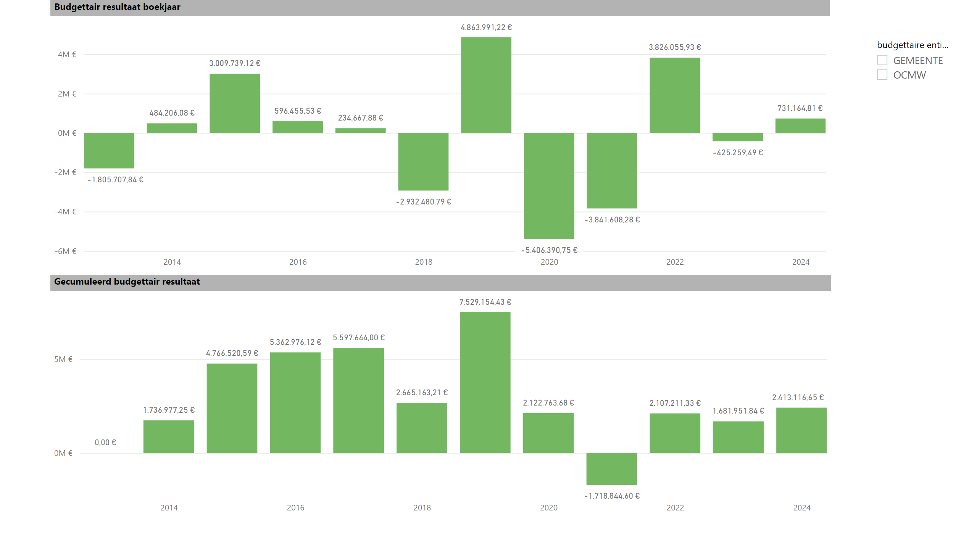
Budgettair resultaat
Notes:
Budgettair resultaat boekjaar
No alt text provided
Gecumuleerd budgettair resultaat
No alt text provided
slicer
No alt text provided

Slide 3
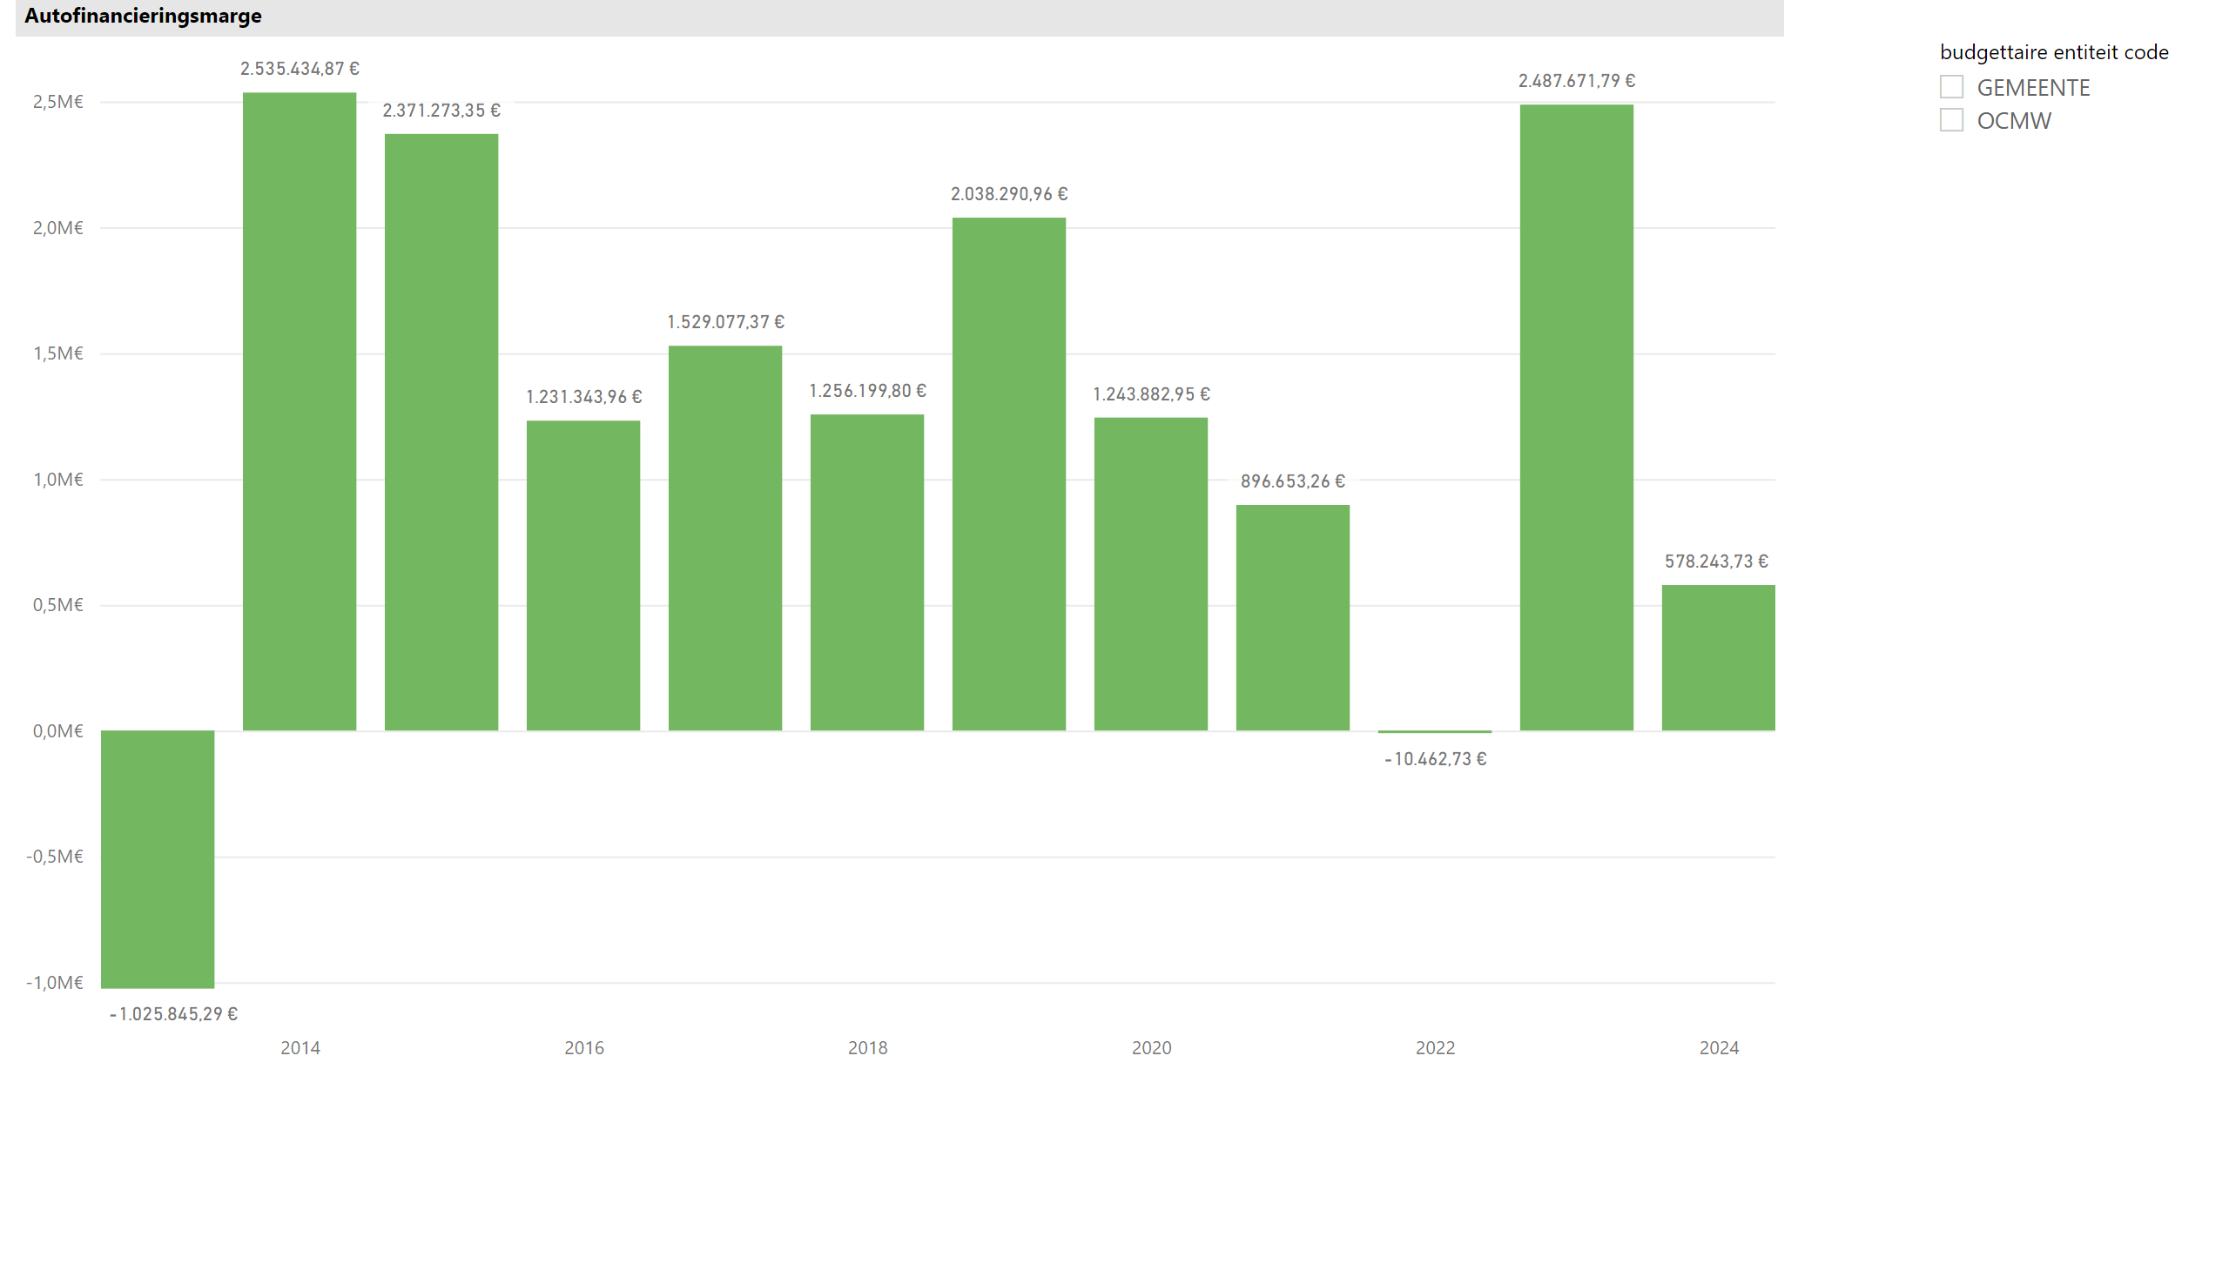
AFM
Notes:
Autofinancieringsmarge
No alt text provided
slicer
No alt text provided

Slide 4
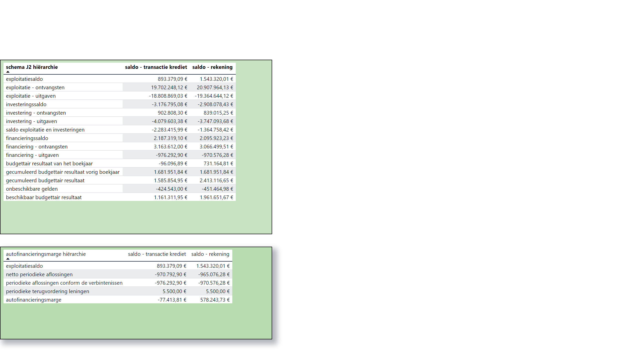
Schema J2
Notes:
tableEx
No alt text provided
tableEx
No alt text provided

Slide 5
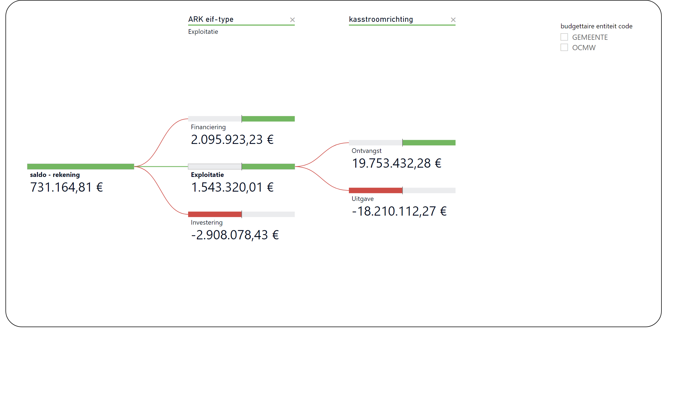
Saldo
Notes:
decompositionTreeVisual
No alt text provided
slicer
No alt text provided

Slide 6
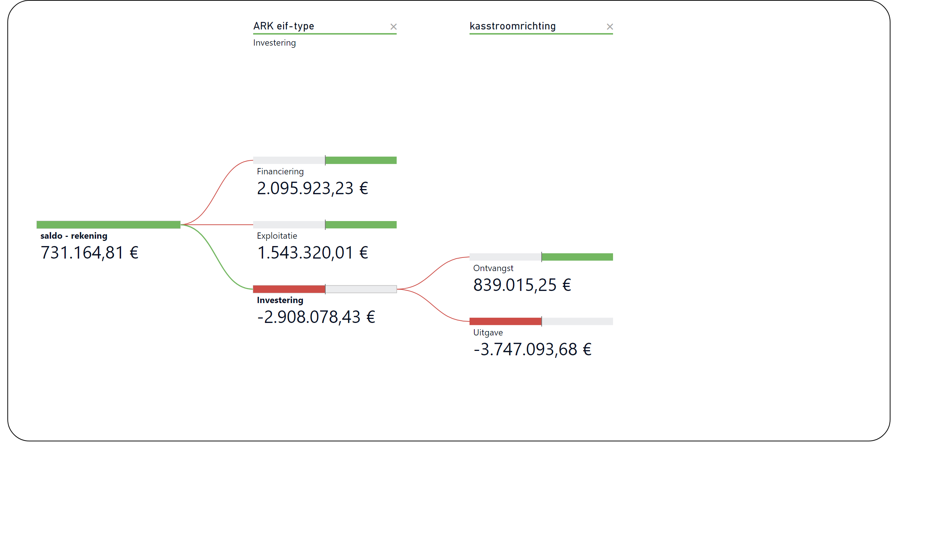
Saldo_1
Notes:
decompositionTreeVisual
No alt text provided

Slide 7
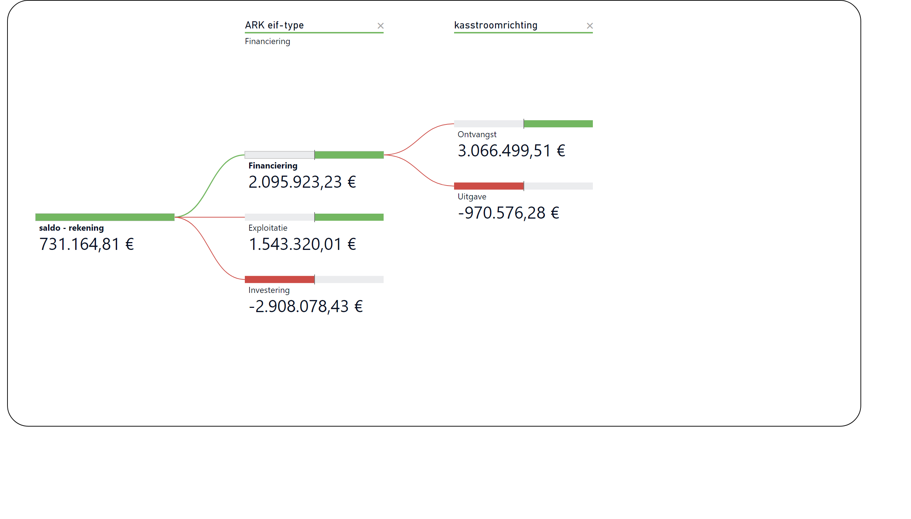
Saldo_2
Notes:
decompositionTreeVisual
No alt text provided

Slide 8
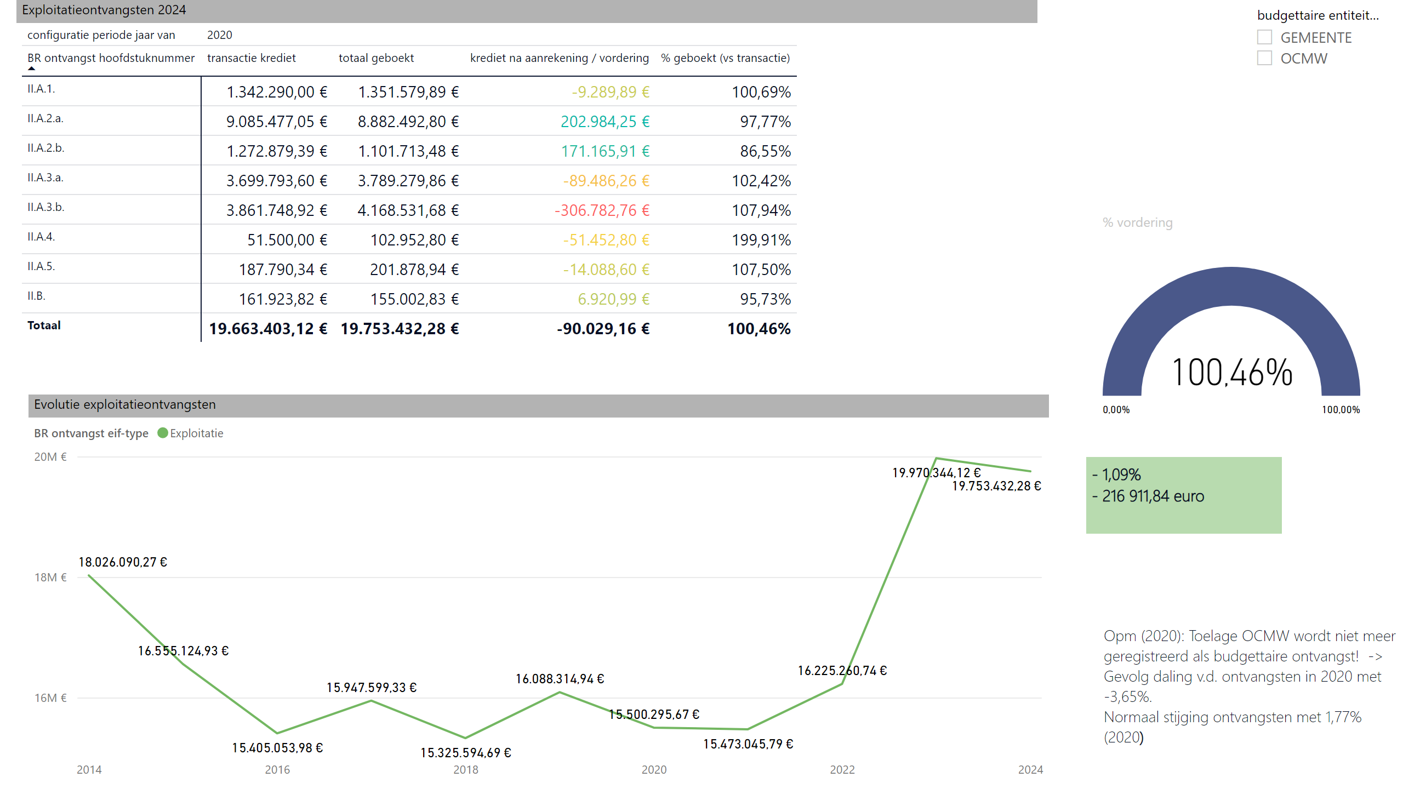
Expl. ontv.
Notes:
Exploitatieontvangsten 2024
No alt text provided
gauge
No alt text provided
Evolutie exploitatieontvangsten
No alt text provided
slicer
No alt text provided
textbox
No alt text provided
textbox
No alt text provided

Slide 9
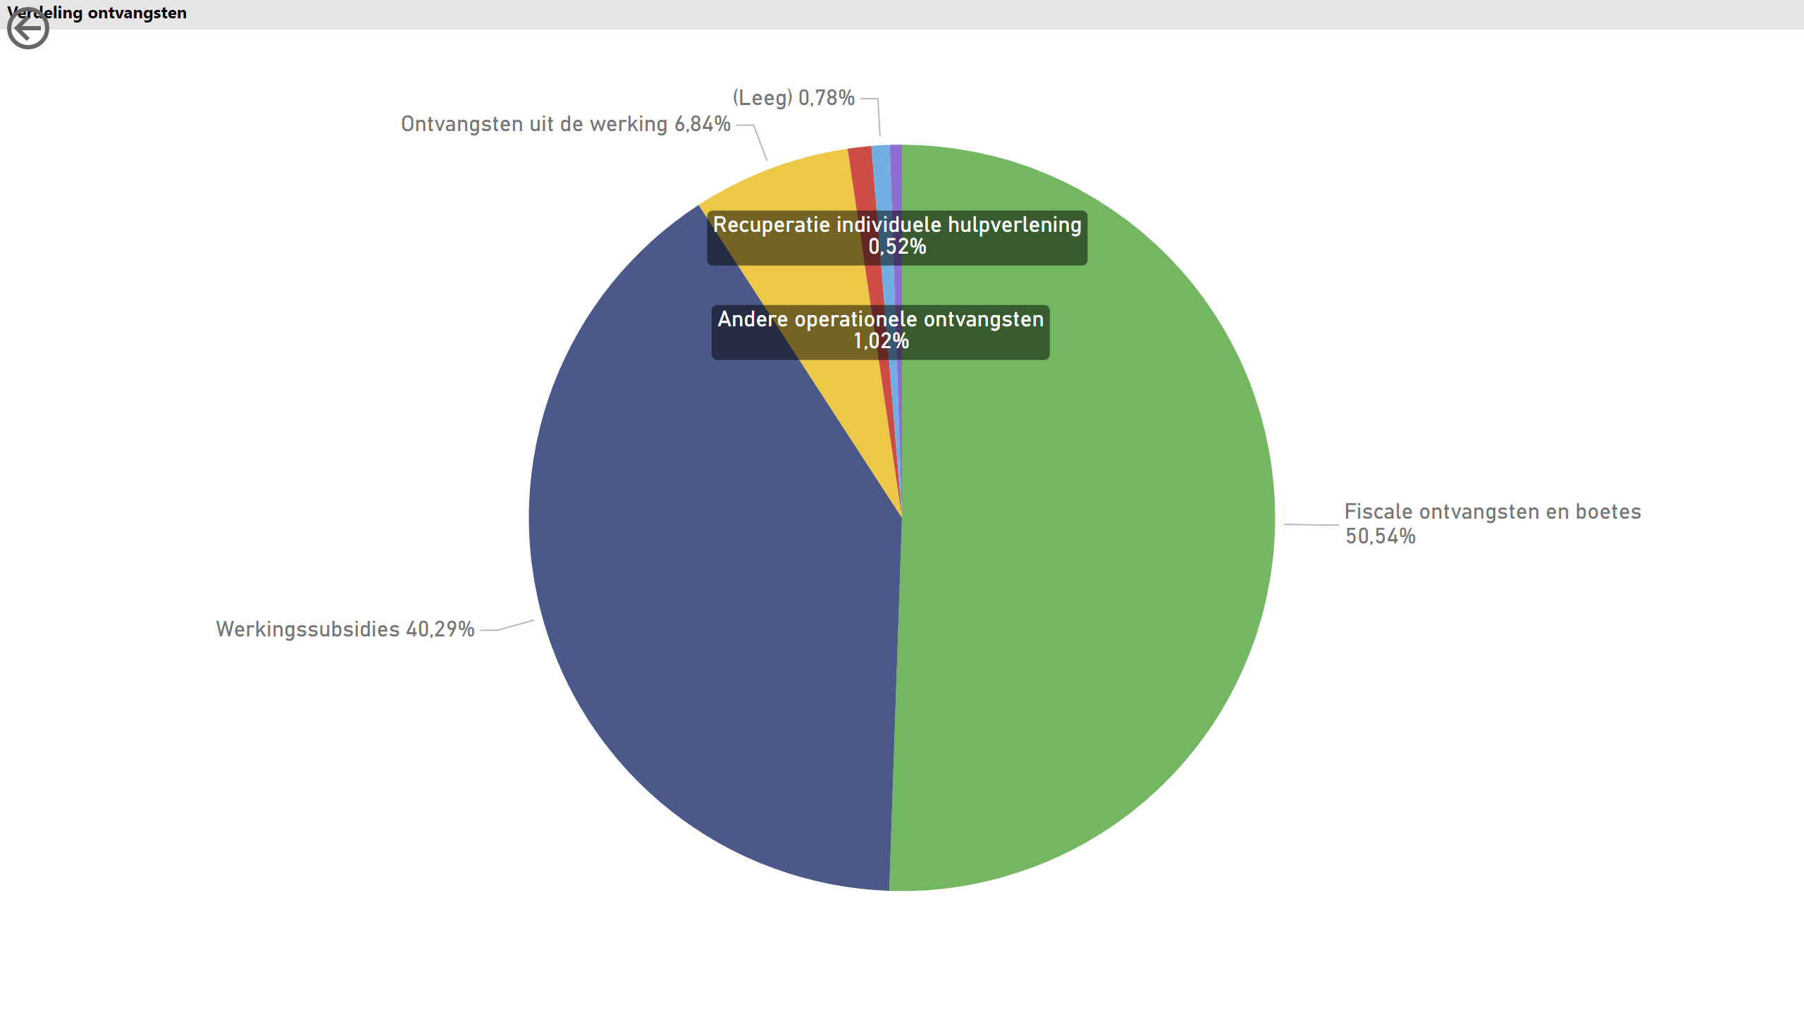
Verdeling ontv.
Notes:
Verdeling ontvangsten
No alt text provided
actionButton
No alt text provided

Slide 10
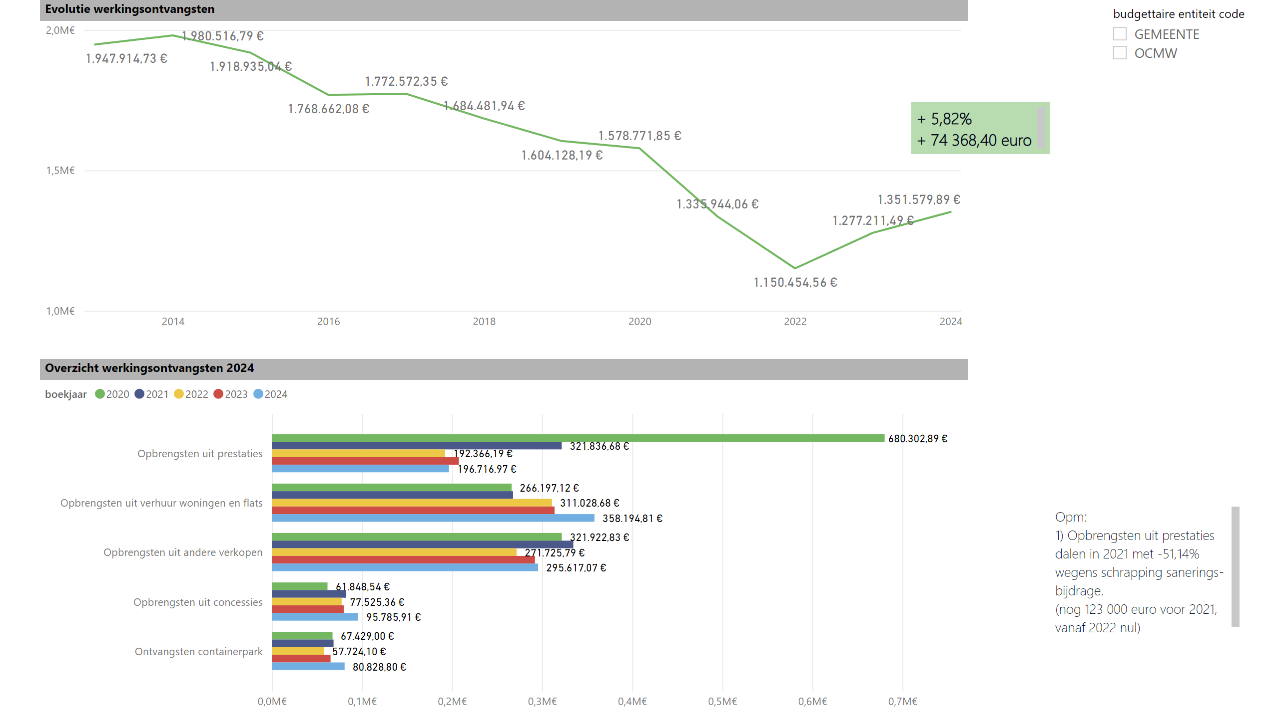
Evol. werkingsontv.
Notes:
Evolutie werkingsontvangsten
No alt text provided
slicer
No alt text provided
Overzicht werkingsontvangsten 2024
No alt text provided
textbox
No alt text provided
textbox
No alt text provided

Slide 11
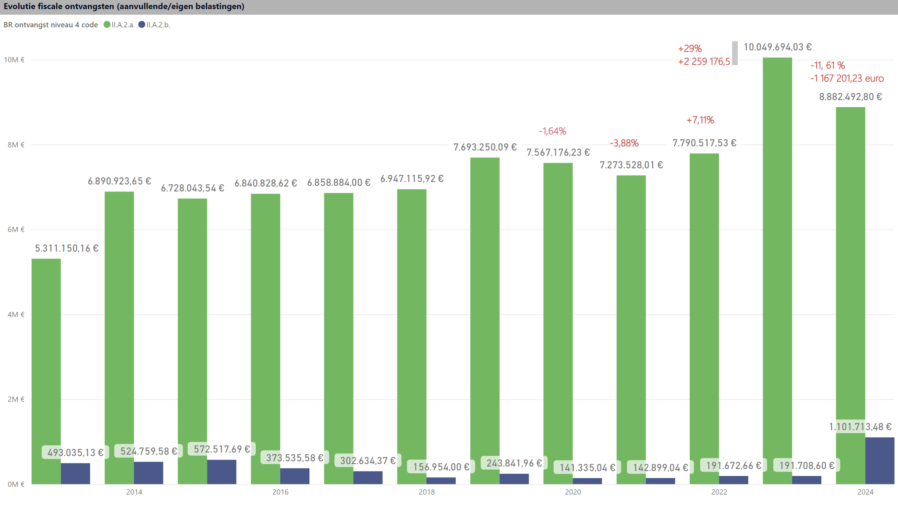
Evol. fisc. ontv.
Notes:
Evolutie fiscale ontvangsten (aanvullende/eigen belastingen)
No alt text provided
textbox
No alt text provided
textbox
No alt text provided
textbox
No alt text provided
textbox
No alt text provided
textbox
No alt text provided
textbox
No alt text provided

Slide 12
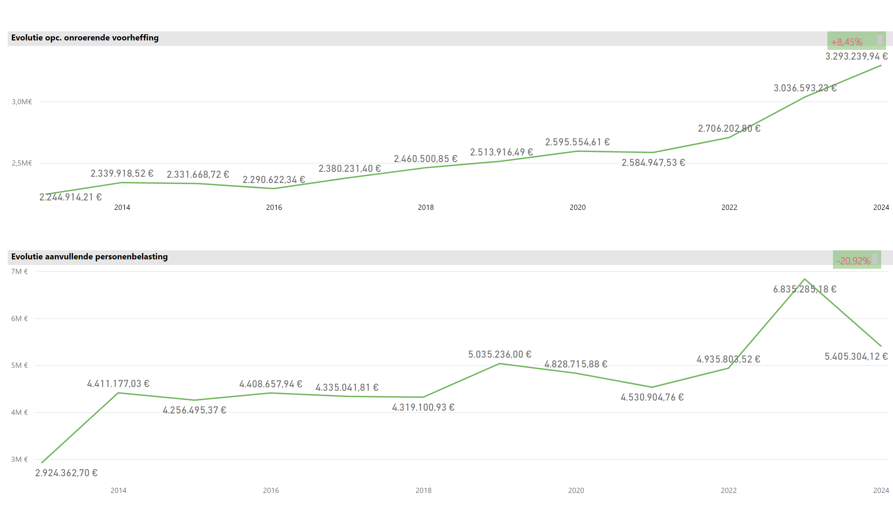
OV & APB
Notes:
Evolutie opc. onroerende voorheffing
No alt text provided
textbox
No alt text provided
Evolutie aanvullende personenbelasting
No alt text provided
textbox
No alt text provided
textbox
No alt text provided

Slide 13
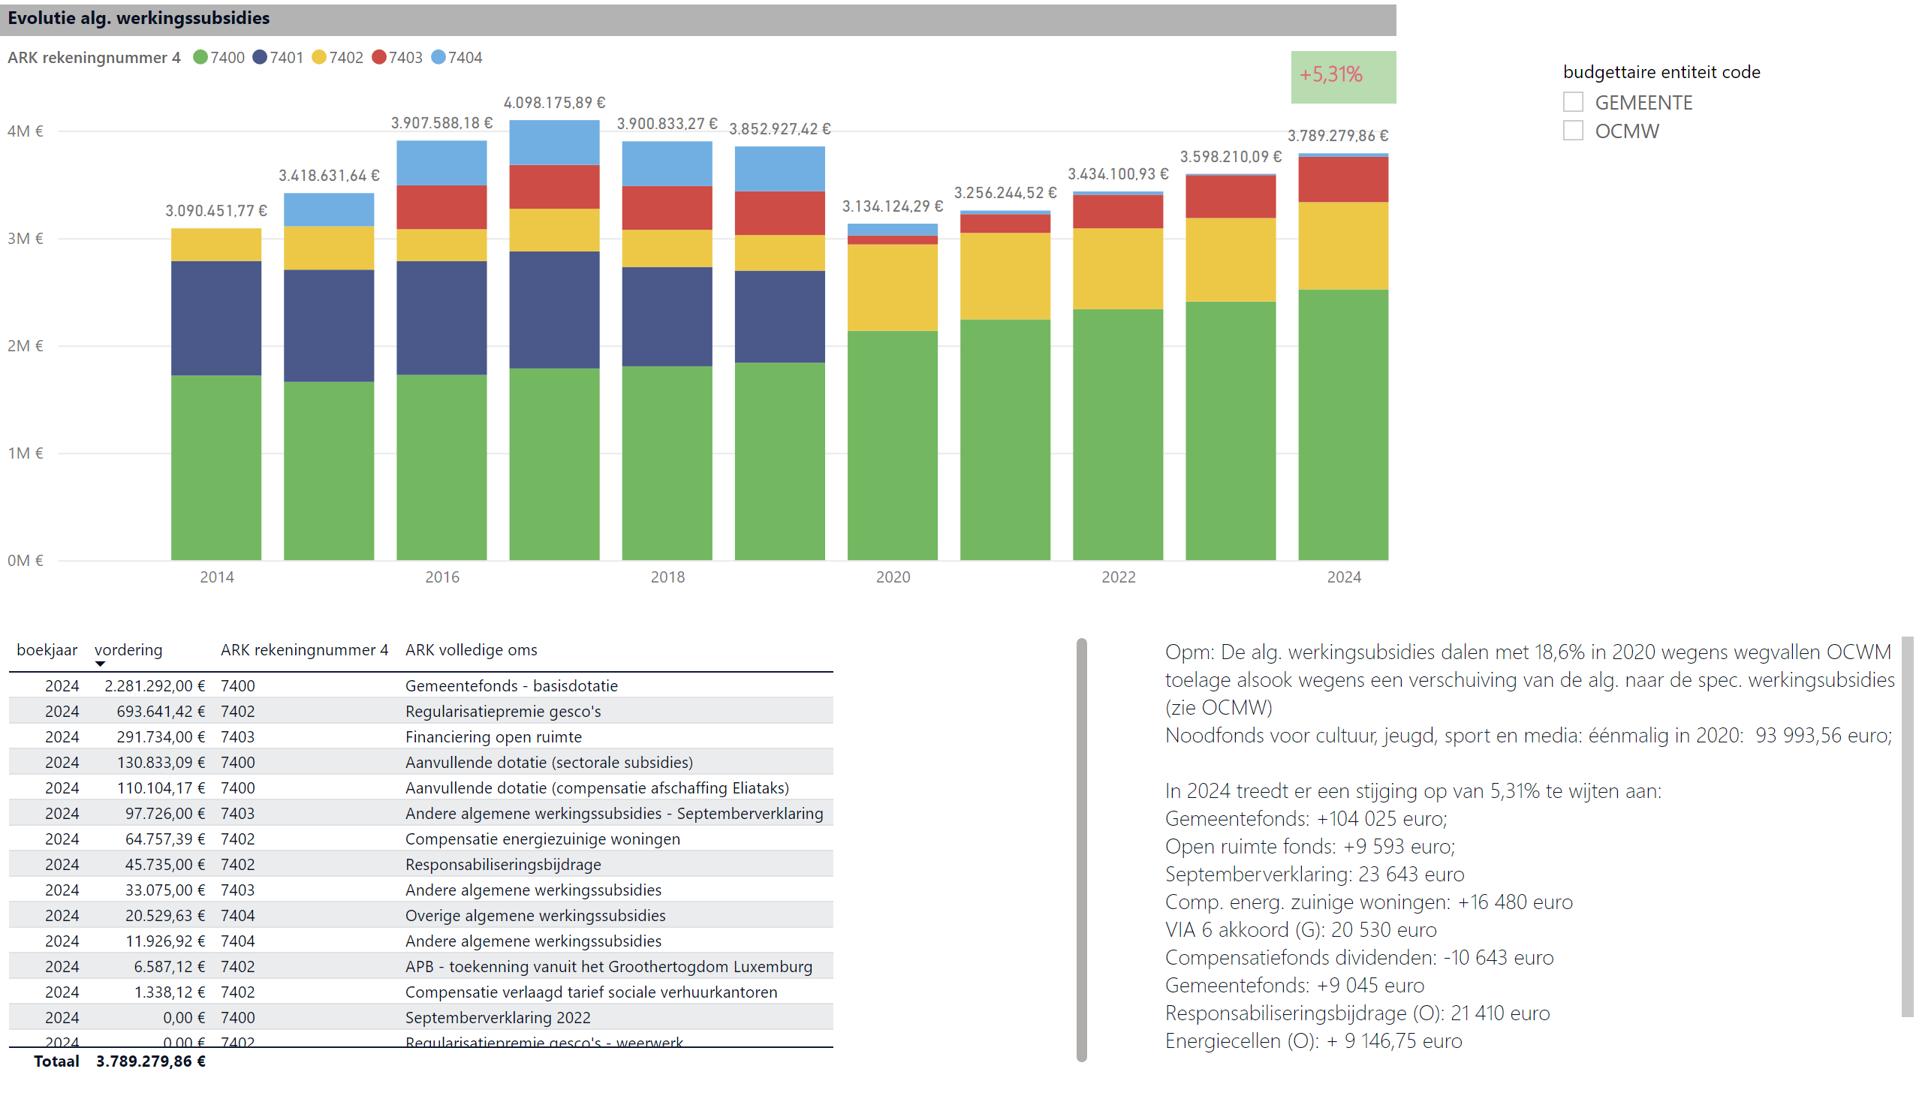
Evol. alg. werkingsubs.
Notes:
Evolutie alg. werkingssubsidies
No alt text provided
slicer
No alt text provided
Evolutie alg. werkingssubsidies
No alt text provided
textbox
No alt text provided
textbox
No alt text provided

Slide 14
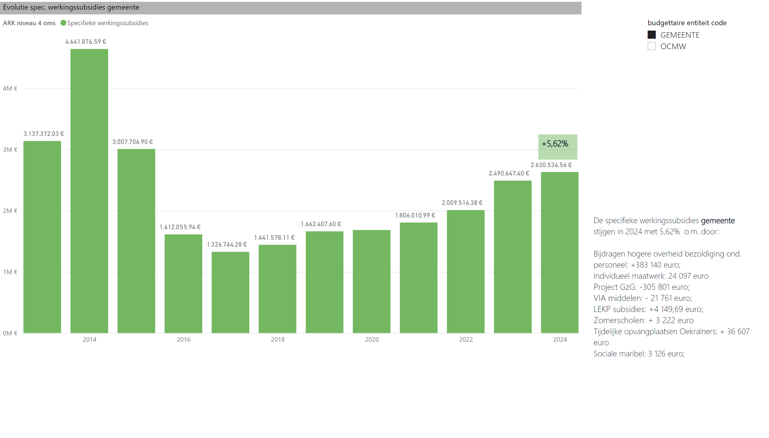
Spec. werkingssubs._G
Notes:
Evolutie spec. werkingssubsidies gemeente
No alt text provided
slicer
No alt text provided
textbox
No alt text provided
textbox
No alt text provided

Slide 15
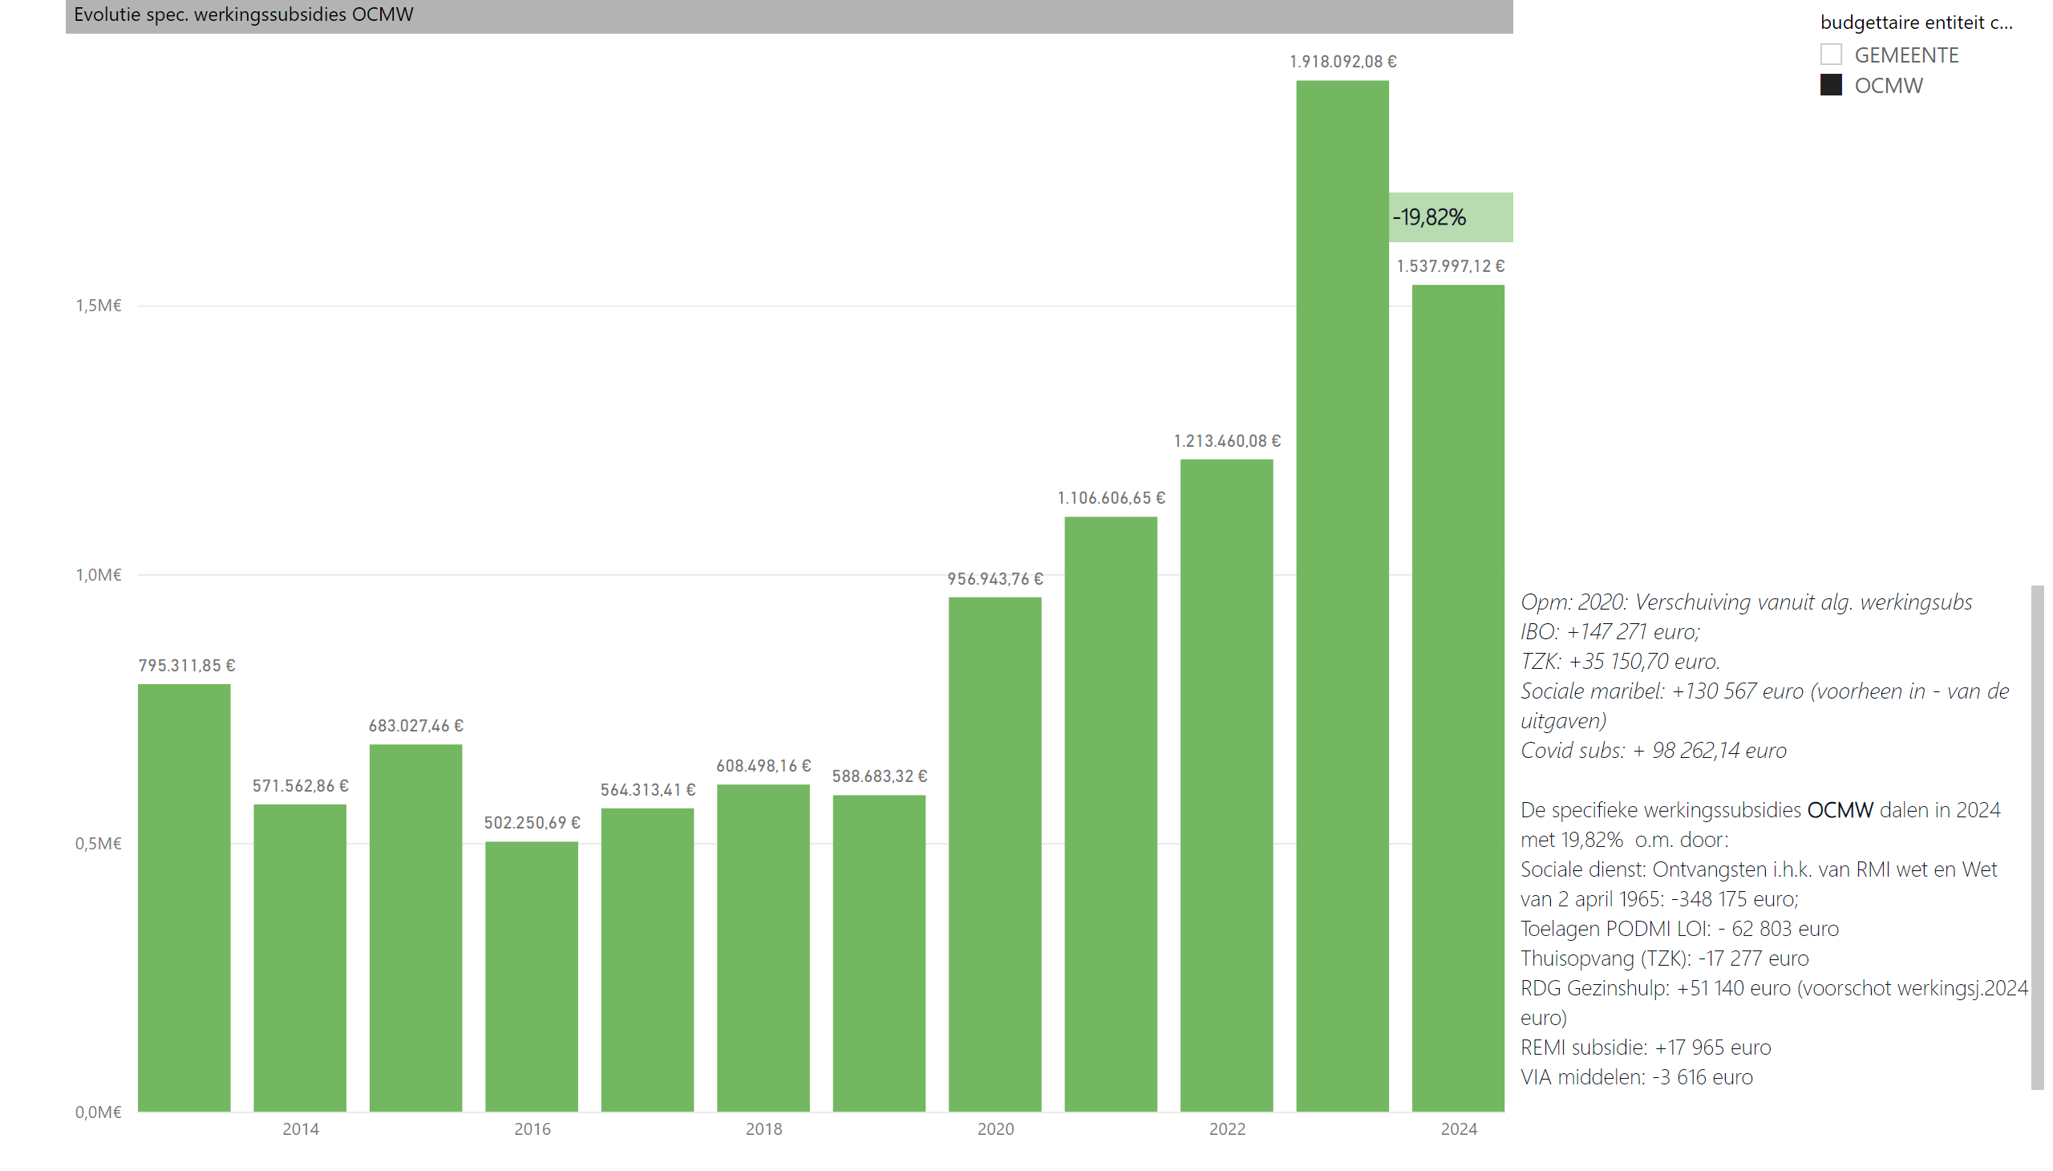
Spec. werkingssubs._O
Notes:
Evolutie spec. werkingssubsidies OCMW
No alt text provided
slicer
No alt text provided
textbox
No alt text provided
textbox
No alt text provided

Slide 16
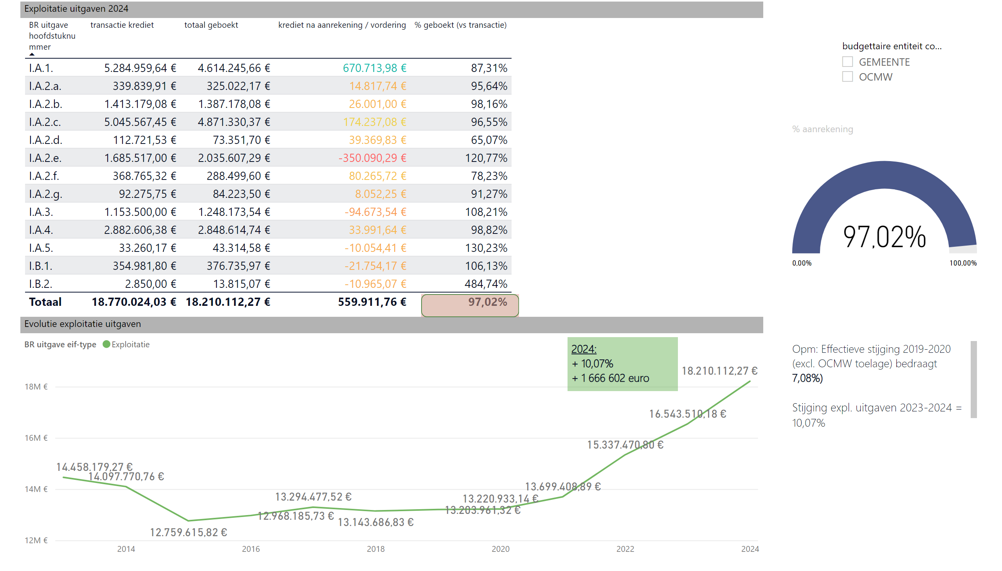
Evol. Expl. uitg.
Notes:
Exploitatie uitgaven 2024
No alt text provided
gauge
No alt text provided
Evolutie exploitatie uitgaven
No alt text provided
slicer
No alt text provided
textbox
No alt text provided
textbox
No alt text provided
shape
No alt text provided

Slide 17
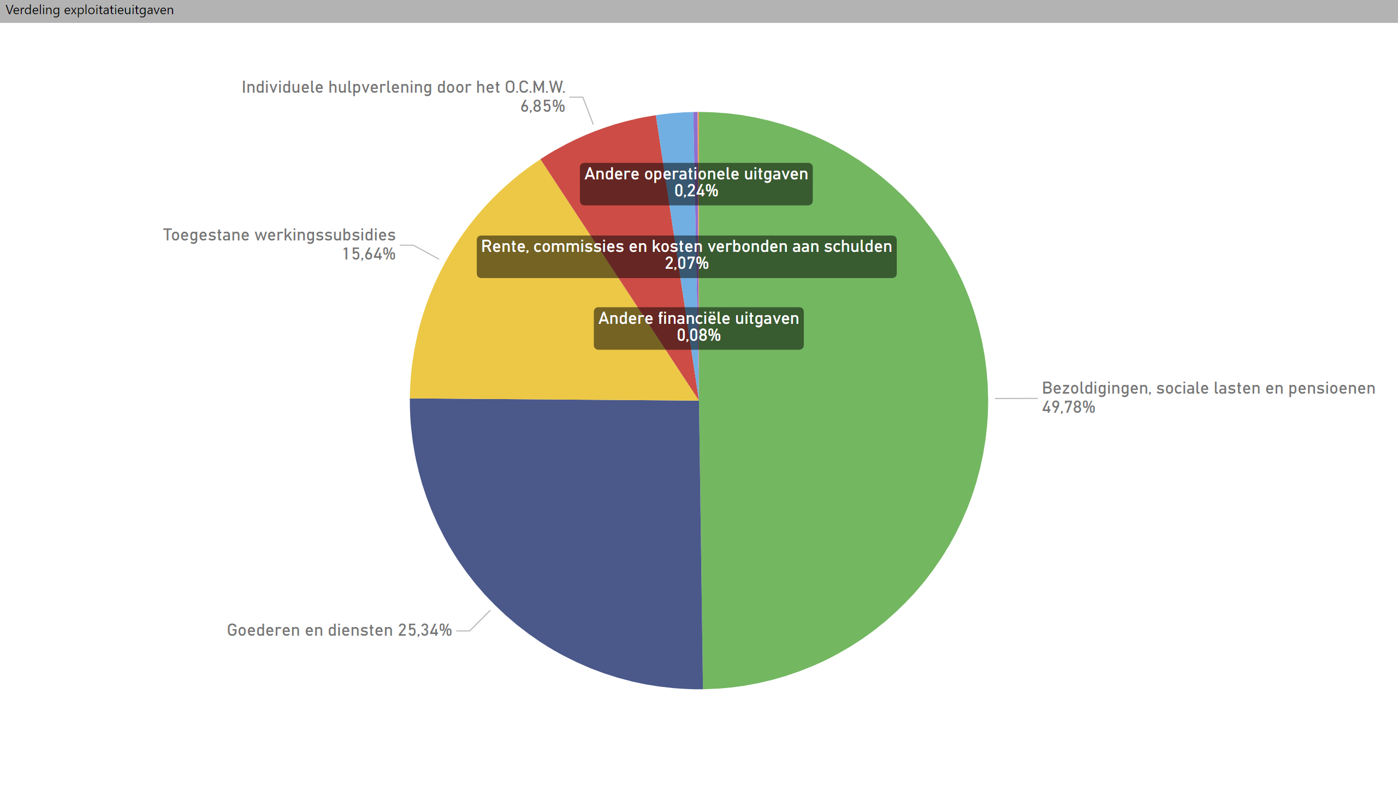
Verdeling expl.uitg
Notes:
Verdeling exploitatieuitgaven
No alt text provided

Slide 18
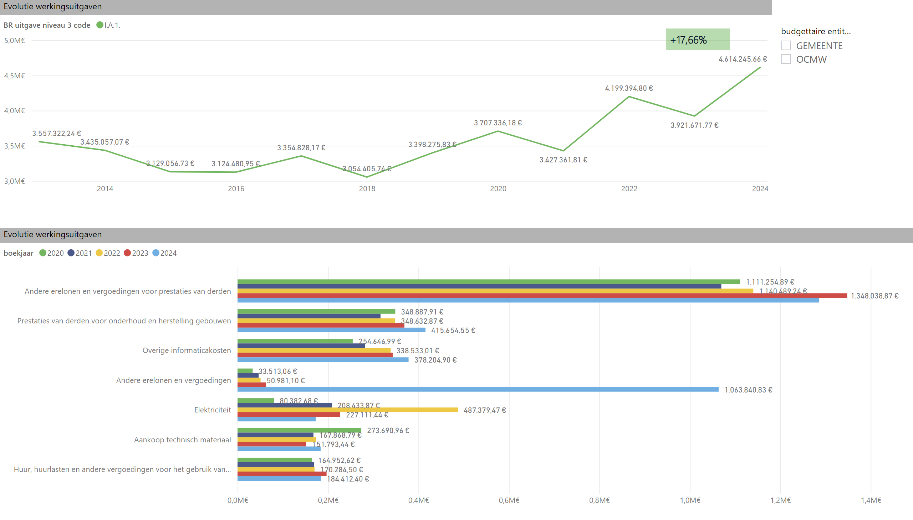
Evol. werkingsuitg.
Notes:
Evolutie werkingsuitgaven
No alt text provided
slicer
No alt text provided
Evolutie werkingsuitgaven
No alt text provided
textbox
No alt text provided

Slide 19
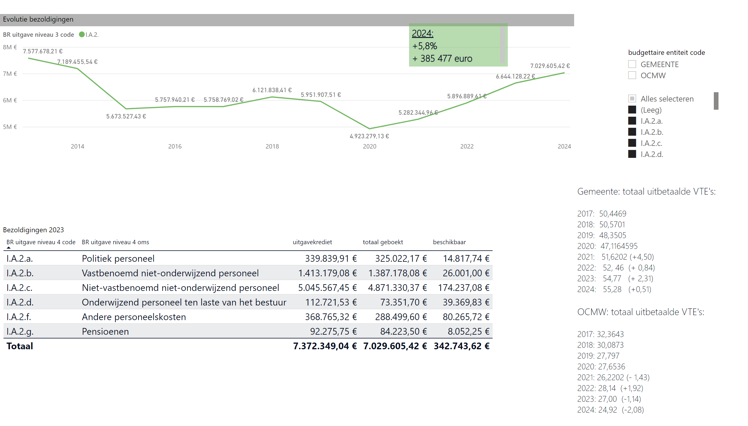
Evolutie bezold.
Notes:
Evolutie bezoldigingen
No alt text provided
slicer
No alt text provided
Bezoldigingen 2023
No alt text provided
textbox
No alt text provided
textbox
No alt text provided
slicer
No alt text provided

Slide 20
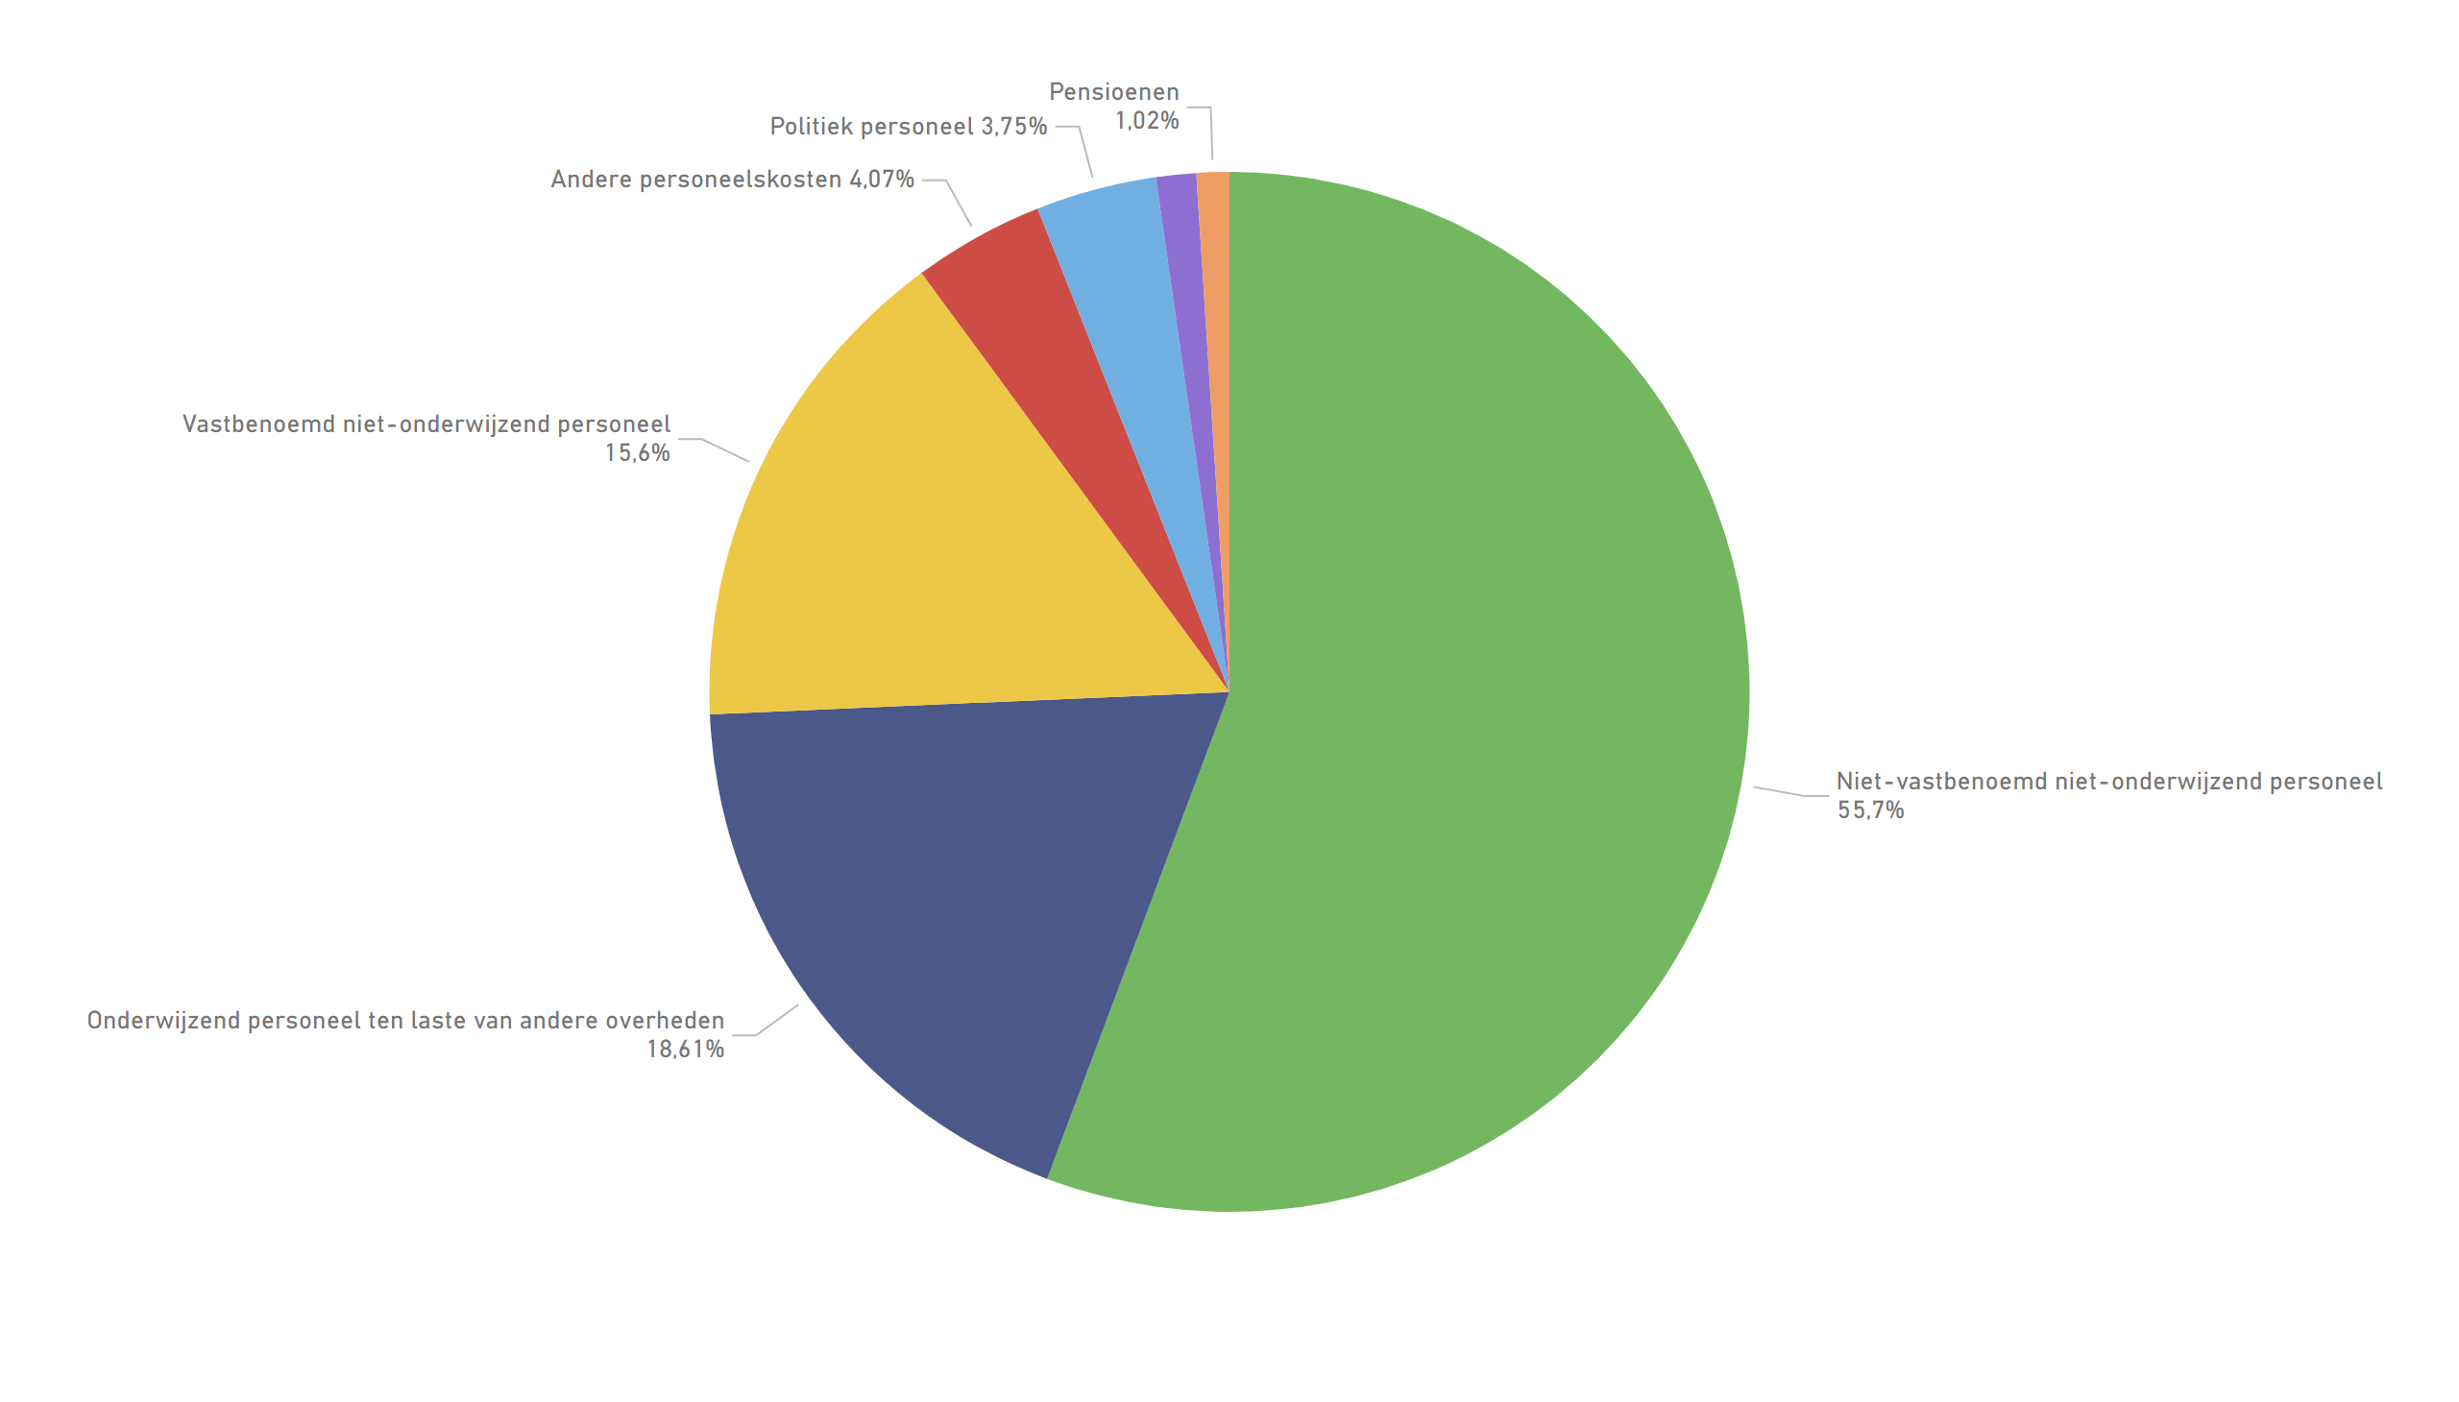
Verd. bezoldigingen
Notes:
pieChart
No alt text provided

Slide 21
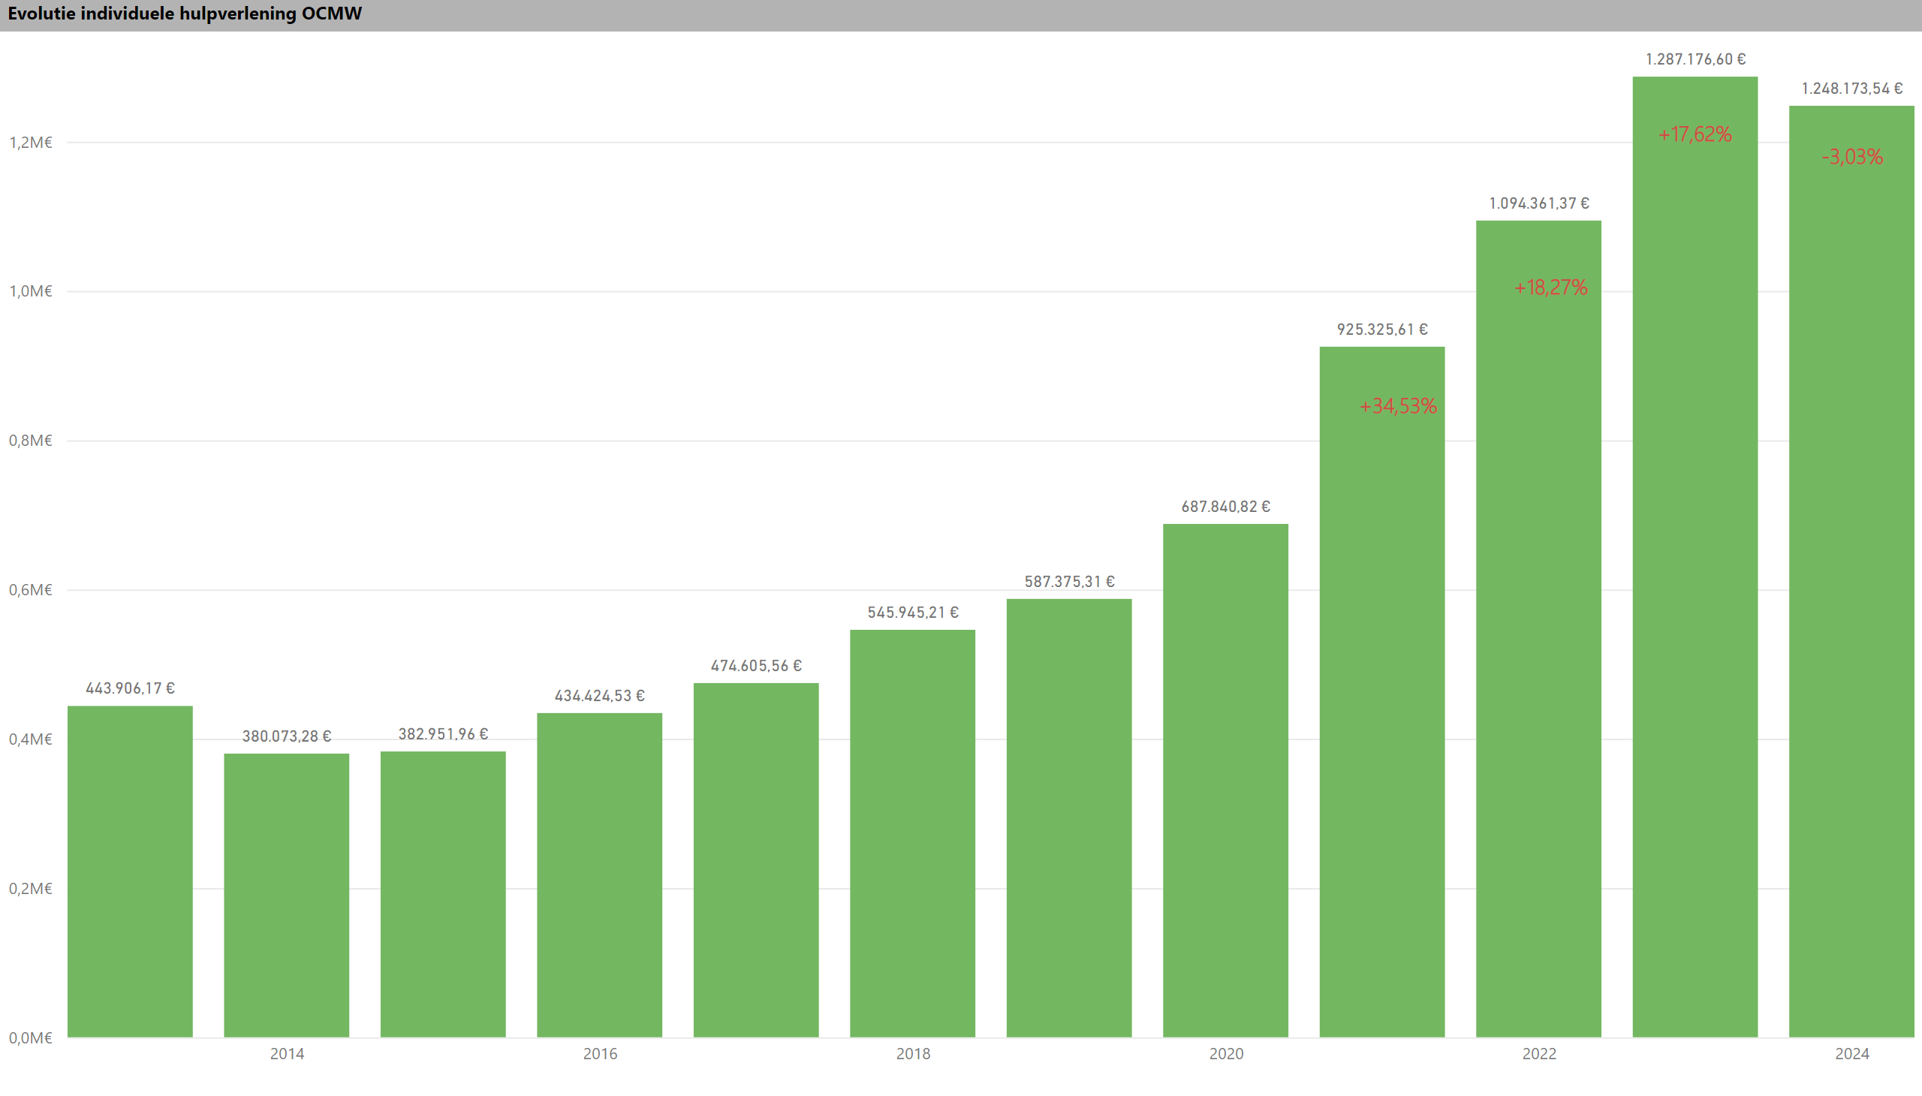
Ind. hulpverl OCMW
Notes:
Evolutie individuele hulpverlening OCMW
No alt text provided
textbox
No alt text provided
textbox
No alt text provided
textbox
No alt text provided
textbox
No alt text provided

Slide 22
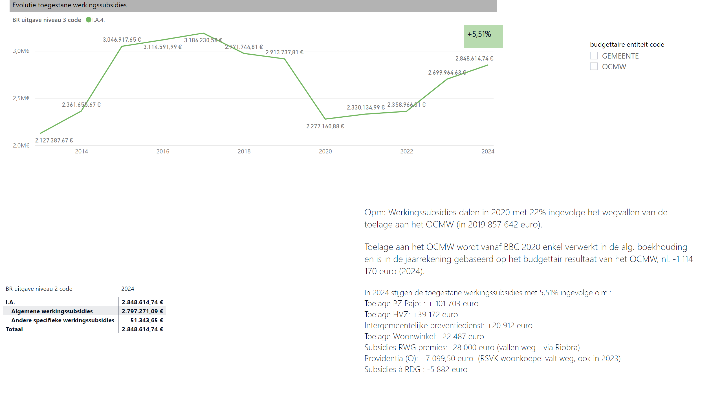
Werkingssubsidies
Notes:
Evolutie toegestane werkingssubsidies
No alt text provided
Evolutie alg. werkingssubsidies
No alt text provided
slicer
No alt text provided
textbox
No alt text provided
textbox
No alt text provided

Slide 23
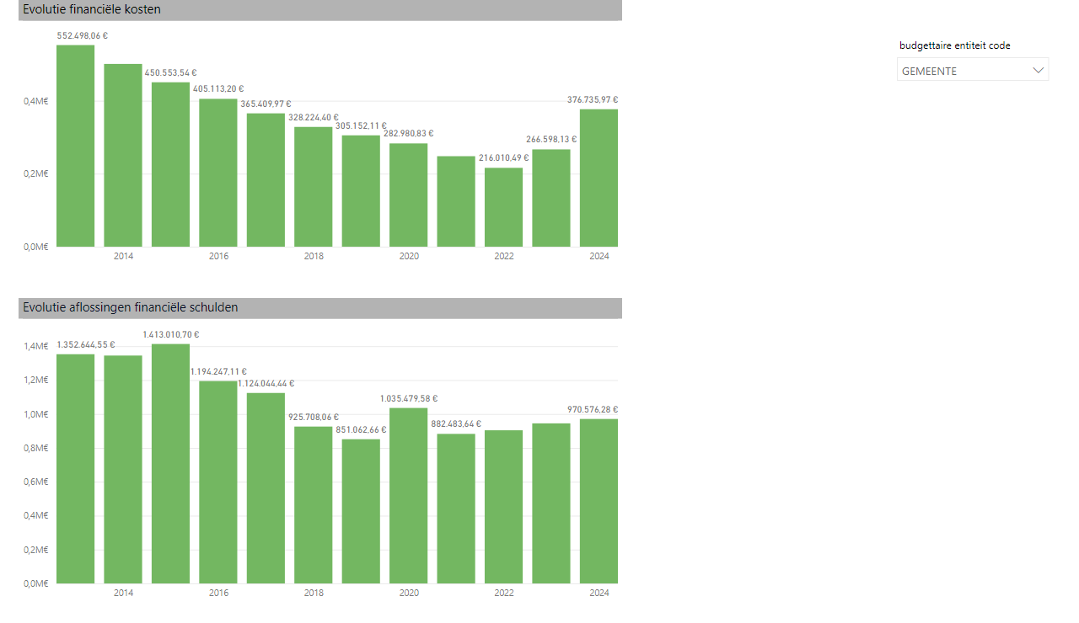
PLU
Notes:
Evolutie financiële kosten
No alt text provided
Evolutie aflossingen financiële schulden
No alt text provided
slicer
No alt text provided

Slide 24
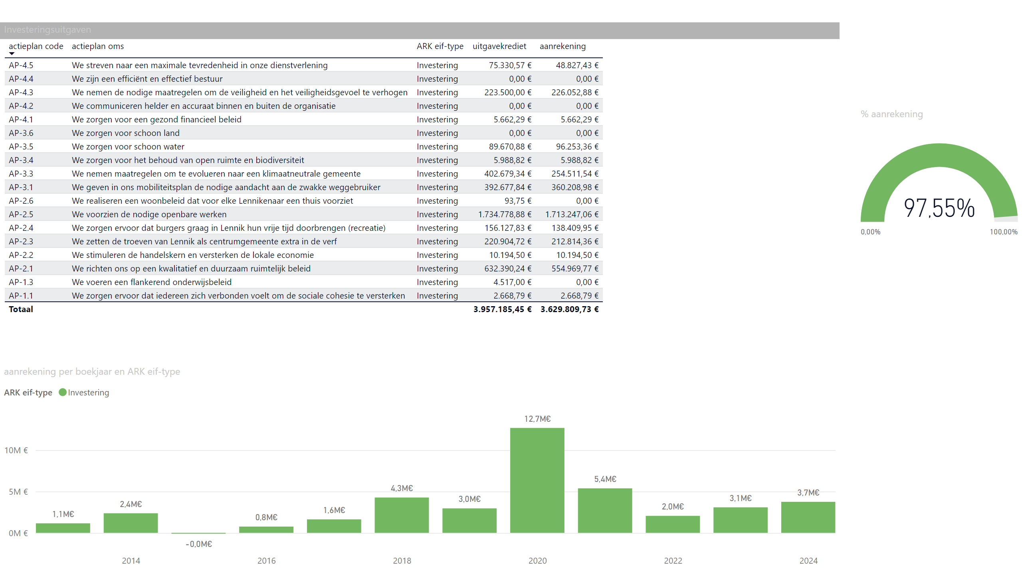
Inv. uitg
Notes:
gauge
No alt text provided
Investeringsuitgaven
No alt text provided
columnChart
No alt text provided

Slide 25
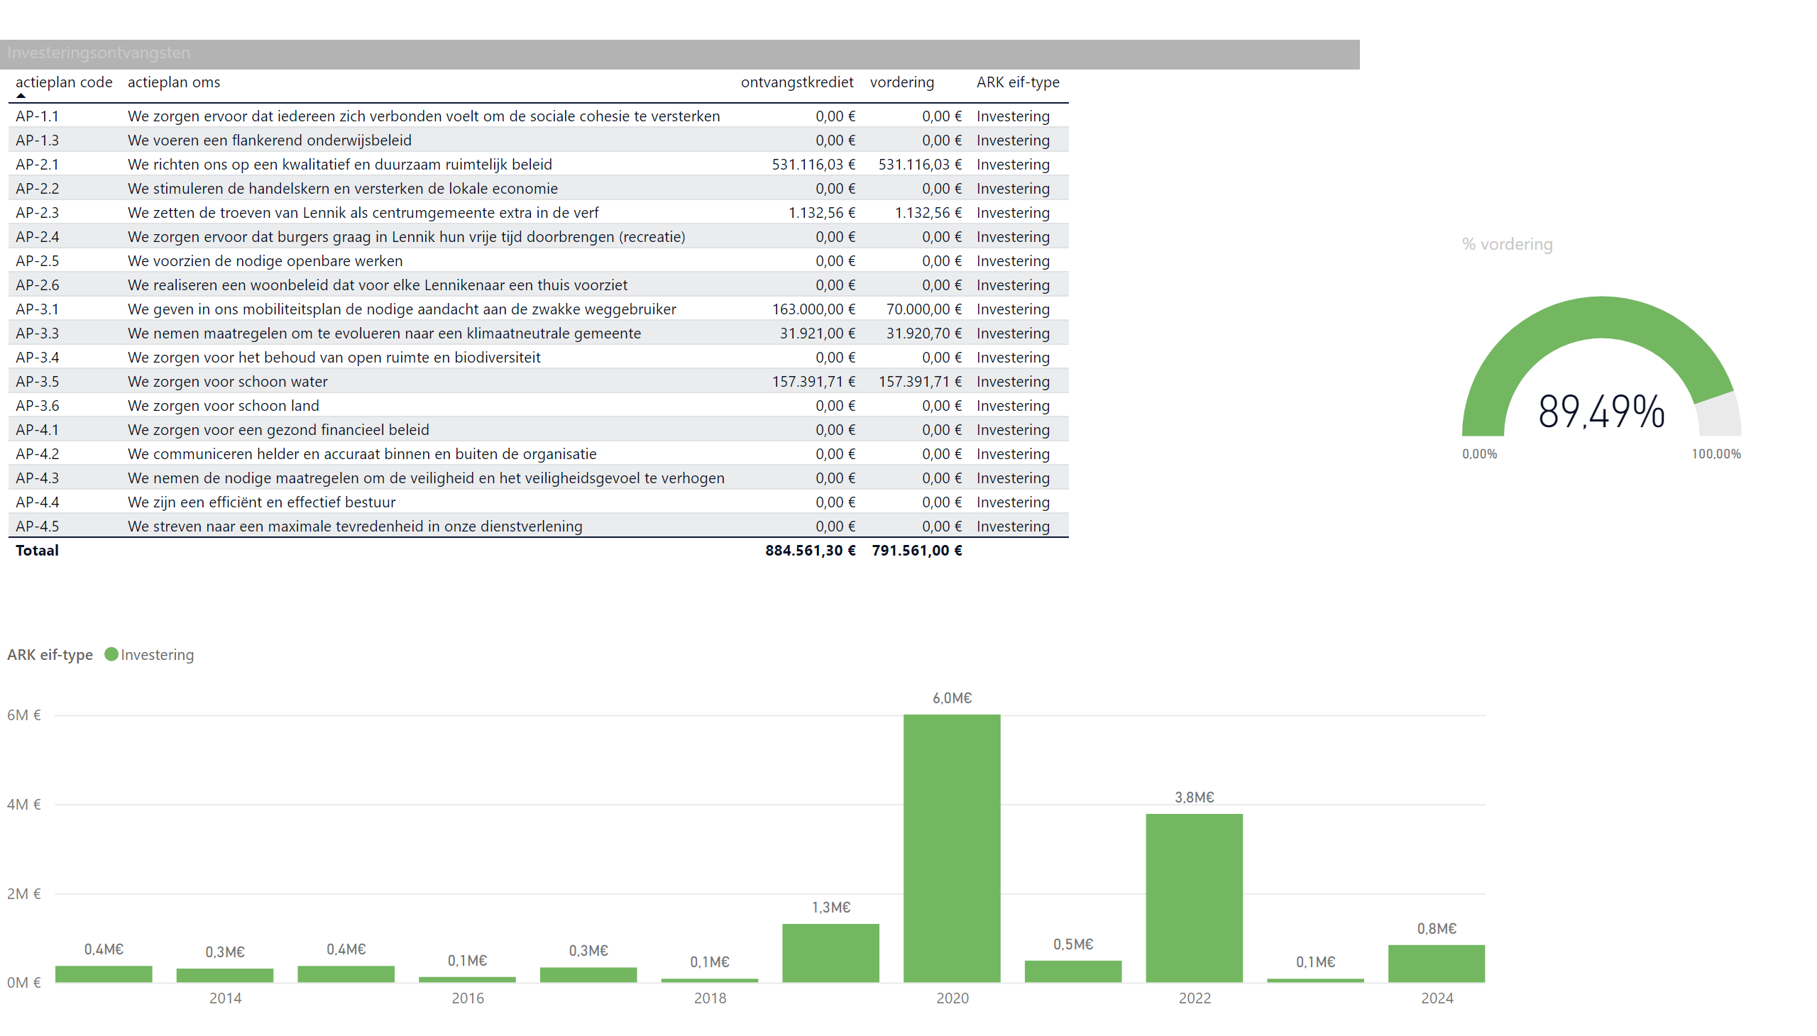
Inv. ontv
Notes:
Investeringsontvangsten
No alt text provided
gauge
No alt text provided
columnChart
No alt text provided

Slide 26
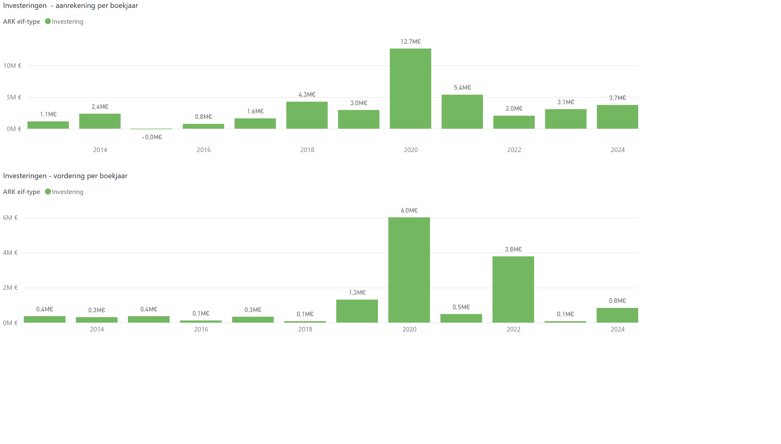
Investeringen (aanrekeningen &vorderingen
Notes:
Investeringen - aanrekening per boekjaar
No alt text provided
Investeringen - vordering per boekjaar
No alt text provided

